Slide 1
8.4 Matrices of General Linear Transformations

Slide 2
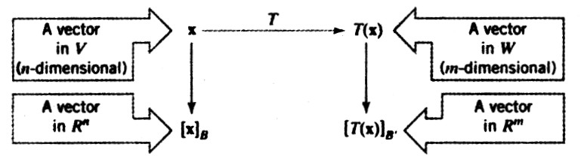
V and W are n and m dimensional vector space
and B and B’ are bases for V and W . then for x in V ,
the coordinate matrix [x]_{B} will be a vector in R^{n}, and
Coordinate matrix [T(x)] _{B’} will be a vector in R^{m}

Slide 3
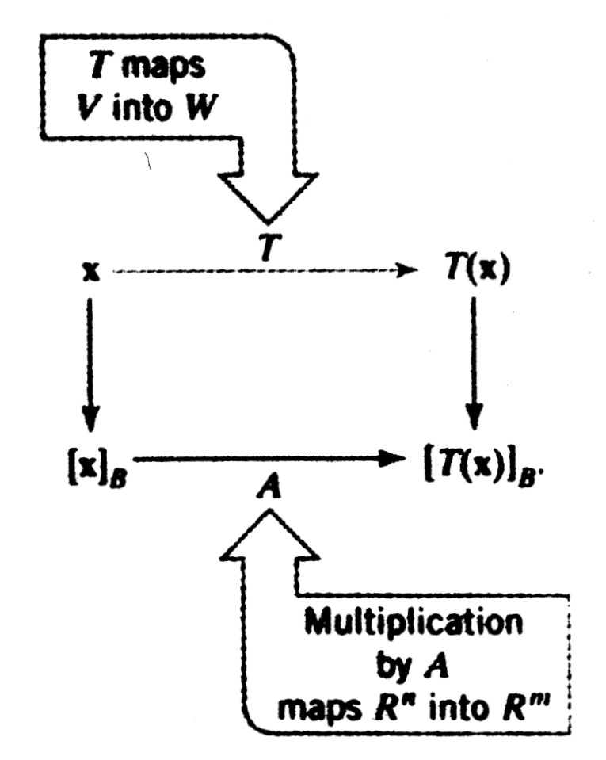
Matrices of Linear Transformations
If we let A be the standard matrix for this transformation then A[x]_{B}=[T (x)]_{B ‘} (1)
The matrix A in (1) is called the matrix for T with respect to the bases B and B’

Slide 4
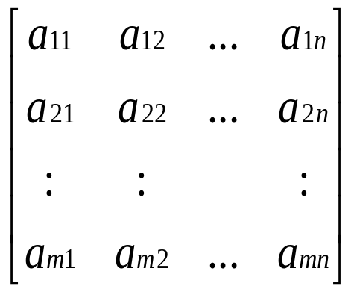
Matrices of Linear Transformations
Let B ={u₁,u₂,…u_{n}} be a basis space W.
A= , so that (1) holds for all vector x
in V.
A[u₁]_{B}=[T (u₁)]_{B’} ,A [u₂]_{B}=[T (u₂)]_{B’}… A[u_{n}]_{B}=[T (u_{n})]_{B’} (2)

Slide 5
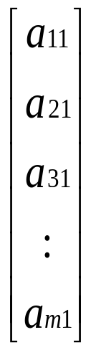
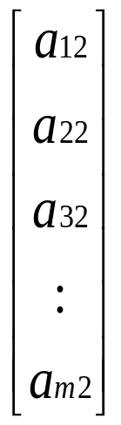
Matrices of Linear Transformations
=[T (u₁)]_{B’}, =[T (u₂)]_{B’},… =[T (u_{n})]_{B’}
which shows that the successive columns of A are the
Coordinate matrices of T (u₁),T (u₂),…. ,T (u_{n}) with
Respect to the basis B ’ .
A=[[T (u₁)]_{B’}| [T (u₂)]_{B’}|……. [T (u_{n})]_{B’}] (3)

Slide 6
Matrices of Linear Transformations
This matrix is commonly denoted by the symbol
[T ]_{B’.B},so that the preceding formula can also be
written as
[T ]_{B’.B} = [[T (u₁)]_{B’}| [T (u₂)]_{B’}|……. [T (u_{n})]_{B’}] (4)
and from (1) this matrix has the property
[T ]_{B’.B}[x]_{B}=[T (x)]_{B’} (4a)

Slide 7
Matrices of Linear Operators
In the special case where V = W , it is usual to take
B = B’ when constructing a matrix for T. In this case
The resulting matrix is called the matrix for T with
respect to the basis B.
[T ]_{B’.B} = [[T (u₁)]_{B}| [T (u₂)]_{B}|……. [T (u_{n})]_{B}] (5)
[T ]_{B} [x]_{B}= [T (x)]_{B} (5a)

Slide 8
Example 1
Let T :P₁ -> P₂ be the transformations defined by
T (p(x)) = xp(x).Find the matrix for T with respect
to the standard bases,B={u₁,u₂} and B’={v₁,v₂,v₃}
where u₁=1 , u₂=x ; v₁=1 , v₂=x ,v₃=x²
Solution:
T (u₁)=T (1)=(x)(1)=x
T (u₂₎=T (x)=(x)(x)=x²

Slide 9


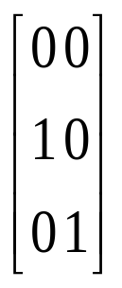
Example 1(Cont.)
[T (u₁)]_{B’}= [T (u₂)]_{B’}=
Thus,the matrix for T with respect to B and B’ is
[T ]_{B’.B} = [[T (u₁)]_{B’}| [T (u₂)]_{B}] =

Slide 10
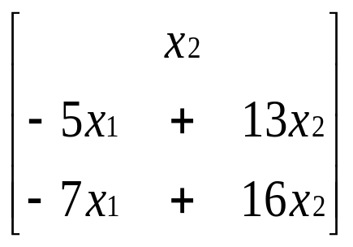
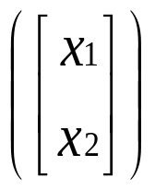
Example 3
Let T :R² -> R³ be the linear transformation defined
by
T =
Find the matrix for the transformation T with
respect to the base B = {u₁,u₂} for R² and
B’ ={v₁,v₂,v₃} for R³,where

Slide 11
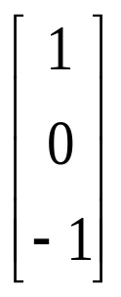




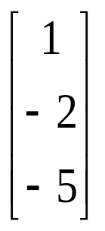
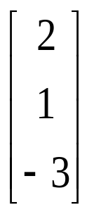
Example 3(Cont)
u₁= u₂= v₁= v₂= v₃=
Solution:
From the formula for T
T (u₁) = T (u₂) =

Slide 12
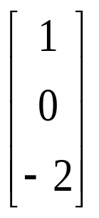
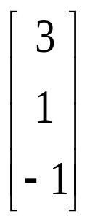
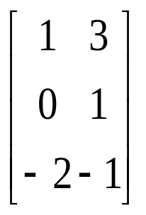
Example 3(Cont)
Expressing these vector as linear combination of
v₁,v₂ and v₃ we obtain T (u₁)=v₁-2v₃ T (u₂)=3v₁+v₂- v₃
Thus
[T (u₁)]_{B’}= [T (u₂)]_{B’}=
[T ]_{B’.B} = [[T (u₁)]_{B’}| [T (u₂)]_{B}] =

Slide 13
Theorem 8.4.1
If T:R^{n} -> R^{m} is a linear transformation and if B and B’ are the standard bases for R^{n} and R^{m} respecively then
[T]_{B’,B} = [T]

Slide 14
Example 6
Let T :P₂ -> P₂ be linear operator defined by
T (p (x))=p (3x-5),that is,
T (c_{o}+c₁x+c₂x²)= c_{o}+c₁(3x-5)+c₂(3x-5)²
(a)Find [T ]_{B} with respect to the basis B ={1,x,x²}
(b)Use the indirect procedure to compute T (1+2x+3x²)
(c)Check the result in (b) by computing T (1+2x+3x²)

Slide 15
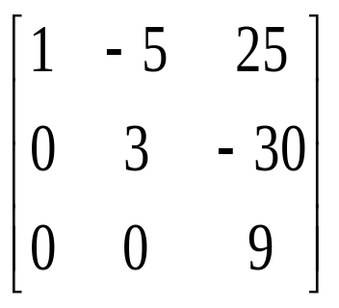
Example 6(Cont.)
Solution(a):
Form the formula for T then
T (1)=1,T (x)=3x-5,T (x²)=(3x-5)²=9x²-30x+25
Thus,
[T ]_{B}=

Slide 16

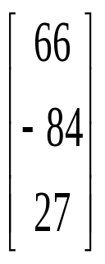
Example 6(Cont.)
Solution(b):
The coordinate matrix relative to B for vector
p =1+2x+3x² is [p]_{B} = .Thus from(5a)
[T (1+2x+3x² )]_{B} =[T (p)]_{B} = [T ]_{B} [p]_{B}
= =
T (1+2x+3x² )=66-84x+27x²

Slide 17
Example 6(Cont.)
Solution(c):
By direct computation
T (1+2x+3x² )=1+2(3x-5)+3(3x-5)²
=1+6x-10+27x²-90x+75
=66-84x+27x²

Slide 18
Theorem 8.4.2
If T₁:U -> V and T₂:V -> W are linear transformation and if B, B^{n} and B’ are bases for U,V and W respectively then
[T₂ 0 T₁]_{B,B’} = [T₂ ]_{B’,B’’}[T₁ ]_{B’’,B}

Slide 19
Theorem 8.4.3
If T:V -> V is a linear operator and if B is a basis for V then the following are equivalent
(a)T is one to one (b)[T]_{B} is invertible
conditions hold
[T⁻¹]_{B} = [T]_{B}⁻¹

Slide 20
8.5 Similarity

Slide 21
SIMILARITY
The matrix of a linear operator T:V V depends on the basis selected for V that makes the matrix for T as simple as possible a diagonal or triangular or triangular matrix.

Slide 22

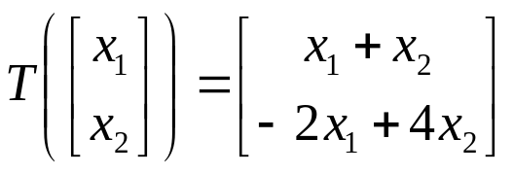
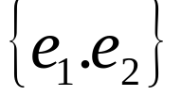

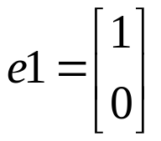
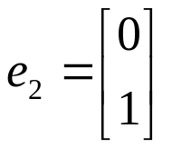

Simple Matrices for Linear Operators
For example,consider the linear operator T: defined by
(1)
And the standard basis B= for ,where
,
The matrix for T with respect to this basis is the standard matrix for T :that is,

Slide 23
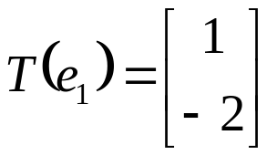
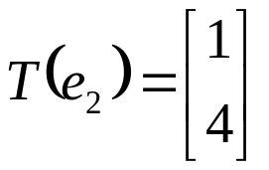
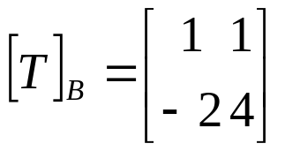
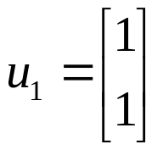
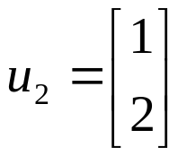

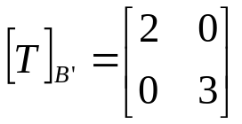
Simple Matrices for Linear Operators (cont.)
Form (1),
, so (2)
In comparison, we showed in Example 4 of Section8.4 that if
(3)
Then the matrix for T with respect to the basis is the diagonal matrix
(4)
This matrix is “simpler”than (2)in the sense that diagonal matrices enjoy special properties that more general matrices do not.

Slide 24
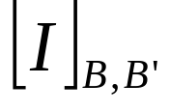


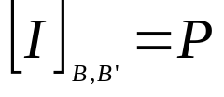
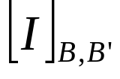
Theorem 8.5.1
If B and B’ are bases for a finite-dimensional vector space V, and if I:V V is the identity operator,then
is the transition matrix from B’ to B.
Proof. Suppose that B= are bases for V. Using the fact that
I(v)=v for all v in V , it follows from Formula(4) of Section 8.4 with
B and B’ reversed that
Thus, from(5),we have ,which shows that is the
transition matrix from B’ to B.

Slide 25



Theorem 8.5.1 Proof(cont.)
The result in this theorem is illustrated in Figure8.5.1
I
V
V
v
v
Basis=B’
Basis=B
Problem: If B and B’are two bases for a finite-dimensional vector space V,and if T:V V is a linear operator,what relationship,if any,exists between the matrices and
I
T
I
v
v
T(v)
T(v)
V
V
V
V
Basis=B’
Basis=B
Basis=B
Basis=B’

Slide 26
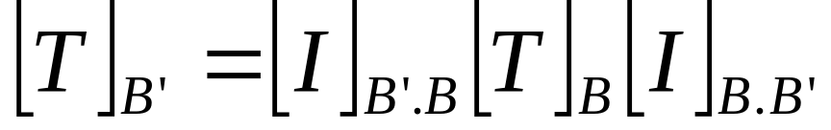
Theorem 8.5.2
Let T:V V be a linear operator on a finite-dimensional vector space V,and let B and B’ be bases for V. Then
Where P is the transition matrix from B’ to B]
Warning.
The interior subscripts are the same
The exterior subscripts are the same

Slide 27
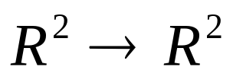
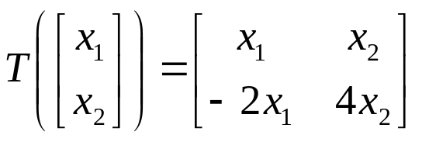



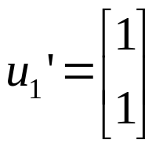
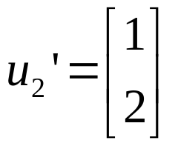
EXAMPLE 1 Using Theorem 8.5.2
Let T: be defined by
Find the matrix of T with respect to the standard basis B= for then use Theorem8.5.2 to find the matrix of T with respect to the basis where
and

Slide 28
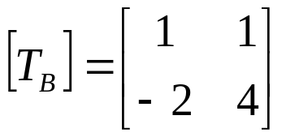
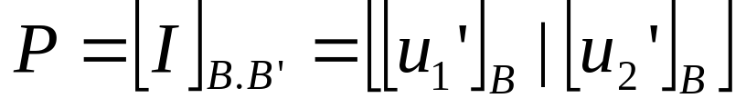
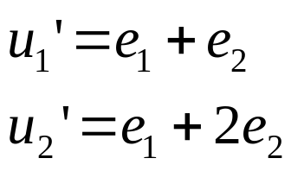
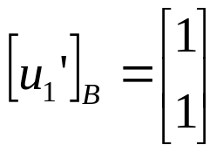
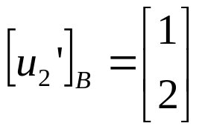
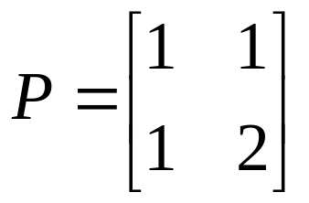
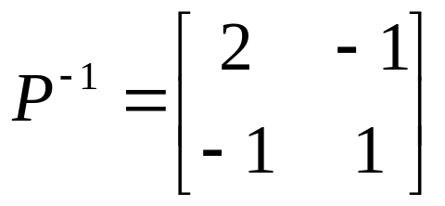
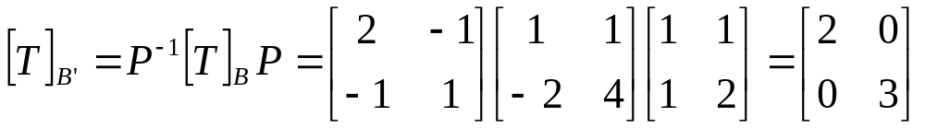
EXAMPLE 1 Using Theorem 8.5.2(cont.)
Solution:
By inspection so that and

Slide 29

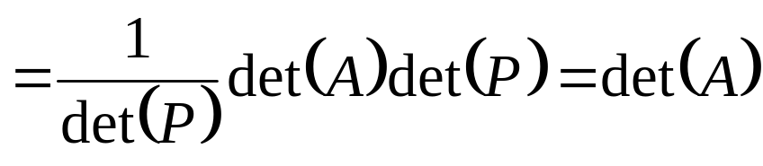
Definition
If A and B are square matrices,we say that B is similar to A if there is an invertible matrix P such that B=
Similarity Invariants Similar matrices often have properties in common;for example,if A and B are similar matrices,then A and B have the same determinant.To see that this is so,suppose that B=

Slide 30
Definition
A property of square matrices is said to be a similarity invariant or invariant under similarity if that property is shared by any two simlar matrices.
Property | Description
Determinant | A and have the same determinant.
Invertibility | A is invertible if and only if is invertible.
Rank | A and have the same rank.
Nullity | A and have the same nullity.

Slide 31

Definition(cont.)
Trace | A and have the same trace.
Characteristic polynomial | A and have the same characteristic polynomial.
Eigenvalues | A and have the same eigenvalues
Eigenspcae dimension | If is an eigenvalue of A and then the eigenspcae of A corresponding to and the eigenspcae of corresponding to have the same dimension.

Slide 32
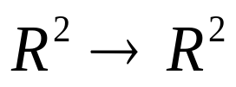
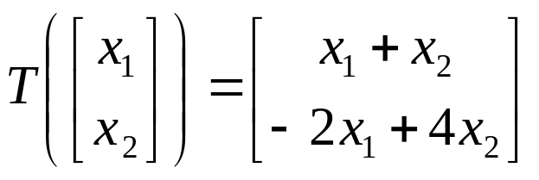
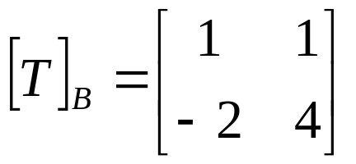
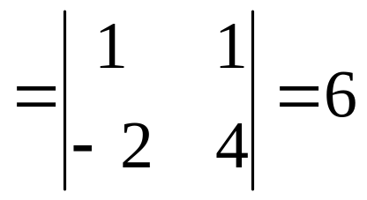

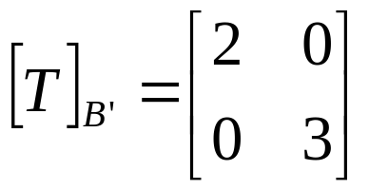
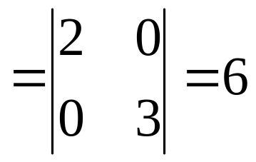
EXAMPLE 2 Determinant of a Linear Operator
Let T: be defined by
Find det(T).
Solution
so det(T)
Had we chosen the basis of example1,then we would have obtained
so det(T)

Slide 33



EXAMPLE3 Reflection About a Line
Let l be the line in the xy-plane that through the origin and makes an angle with the positive x-axis, where .As illustrated in Figure 8.5.4,let T:
be the linear operator that maps each vector into its reflection about the line l.
(a)Find the standard matrix for T.
(b)Find the reflection of the vector x =(1,2)about the line l through the origin that makes an angle of
with the positive x-axis.

Slide 34




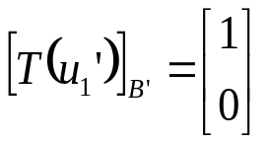






EXAMPLE3 Reflection About a Line(cont.)
Solution(a)
Instead of finding directly,we shall first find the matrix ,where
so and
Thus,
,

Slide 35





EXAMPLE3 Reflection About a Line(cont.)
Solution(b).It follow from part(a)that the formula for T in matrix notation is
Substituting in this formula yields
So
Thus,

Slide 36



Eigenvalues of a Linear Operator
Eigenvectors and eigenvalues can be defined for linear operators as well as matrices.A scalar is called an eigenvalue of a linear operator T:V V if there is a nonzero vector x in V such that .The vector x is called an eigenvector of T corresponding to . Equivalently,the eigenvectors of T corresponding to are the nonzero vectors in the kernel of
I-T.this kernel is called the eigenspcae of T corresponding to .
1.The eigenvalues of T are the same as the eigenvalues of .
2.A vector x is an eigenvector of T corresponding to if and only if its corrdinate matrix is an eigenvector of corresponding to .

Slide 37

EXAMPLE4
Eigenvalues and Bases for Eigenspaces
Find the eigenvalues and bases for the eigenvalues of the linear operator
defined by

Slide 38










EXAMPLE4 (cont.)
Eigenvalues and Bases for Eigenspaces
Solution
The matrix for T with respect to the standard basis is
T are and
, corresponding to has the basis where

Slide 39



EXAMPLE5
Diagonal Matrix for a Linear Operator
Let T= be the linear operator given by
Find a basis for relative to which the matrix
for T is diagonal.

Slide 40




EXAMPLE5 (cont.)
Diagonal Matrix for a Linear Operator
Solution(1/3)
If denotes the standard basis for ,then
So that the standard matrix for T is
(13)
Let P be the transition matrix from the unknown basis B’to the standard basis B, ,will be related by

Slide 41









EXAMPLE5 (cont.)
Diagonal Matrix for a Linear Operator
Solution (2/3)
We found that the matrix in (13)is diagonalized by
The basis to the standard basis
the columns of P are and so that

Slide 42




EXAMPLE5 (cont.)
Diagonal Matrix for a Linear Operator
Solution (3/3)
From the given formula for T we have
So that
Thus

